Slide 1
ORM CLASS INHERITANCE

Slide 2
ORM Inheritance
ORM provides three (3) inheritance strategies
Joined - AKA Normalized
Single Table - (Denormalized)
Table per Class

Slide 3
JOINED/ NORMALIZED
STRATEGY

Slide 4
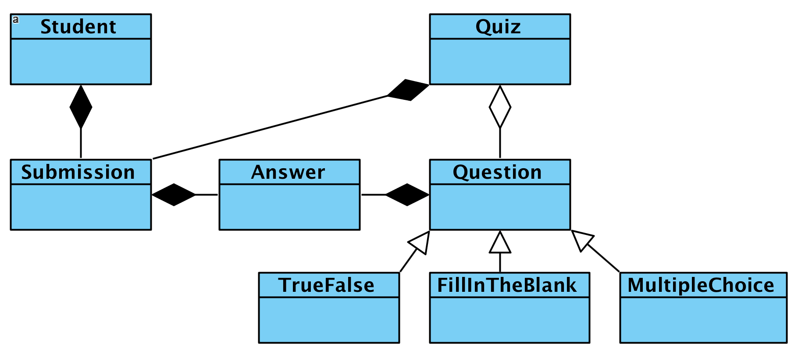

Slide 5
BaseQuestionJoined.java
@Entity
@Table(name = "JOINED_BASE_QUESTION")
@Inheritance(strategy=InheritanceType.JOINED)
public class BaseQuestionJoined {
@Id
@GeneratedValue(strategy=GenerationType.IDENTITY)
private int id;
private int points;
private String title, description, instructions; ...
}

Slide 6
TrueOrFalseQuestionJoined.java
@Entity
@Table(name =
"JOINED_TRUE_OR_FALSE_QUESTION")
public class TrueOrFalseQuestionJoined
extends BaseQuestionJoined {
@Column(name = "IS_TRUE", nullable = false)
private Boolean isTrue;
}

Slide 7
FillInTheBlankQuestionJoined.java
@Entity
@Table(name =
"JOINED_FILL_IN_THE_BLANK_QUESTION")
public class FillInTheBlankQuestionJoined
extends BaseQuestionJoined {
@Column(name = "VARIABLES", nullable = false)
private String variables;
}

Slide 8
joined_base_question
CREATE TABLE `joined_base_question` (
`id` int(11) NOT NULL AUTO_INCREMENT,
`description` varchar(255) DEFAULT NULL,
`instructions` varchar(255) DEFAULT NULL,
`points` int(11) NOT NULL,
`title` varchar(255) DEFAULT NULL,
PRIMARY KEY (`id`)
)

Slide 9
joined_true_or_false_question &
joined_fill_in_the_blank_question
CREATE TABLE `joined_true_or_false_question` (
`id` int(11) NOT NULL,
`is_true` bit(1) NOT NULL,
PRIMARY KEY (`id`)
)
CREATE TABLE `joined_fill_in_the_blank_question` (
`id` int(11) NOT NULL,
`variables` varchar(255) NOT NULL,
PRIMARY KEY (`id`)
)

Slide 10
*RepositoryJoined.java
public interface BaseQuestionRepositoryJoined
extends CrudRepository
<BaseQuestionJoined, Integer>{}
public interface TrueOrFalseQuestionRepositoryJoined
extends CrudRepository
<TrueOrFalseQuestionJoined, Integer>{}
public interface FillInTheBlankQuestionRepositoryJoined
extends CrudRepository
<FillInTheBlankQuestionJoined, Integer>{}

Slide 11
TestJoined.java
@Test
public class ServiceJoined {
@Autowired
BaseQuestionRepositoryJoined baseRepo;
@Autowired
FillInTheBlankQuestionRepositoryJoined fillRepo;
@Autowired
TrueOrFalseQuestionRepositoryJoined trueRepo;
...
}

Slide 12
/api/inheritance/joined/base
public void testCreateBaseQuestion() {
BaseQuestionJoined q = new BaseQuestionJoined();
q.setDescription("descriptions 123");
q.setInstructions("instructions 123");
q.setPoints(123);
q.setTitle("title 123");
baseRepo.save(q);
}

Slide 13
/api/inheritance/joined/fill
public void testCreateFillQuestion() {
FillInTheBlankQuestionJoined q = new
FillInTheBlankQuestionJoined();
q.setDescription("descriptions 234");
q.setInstructions("instructions 234");
q.setPoints(234);
q.setTitle("title 234");
q.setVariables("variables 234");
fillRepo.save(q);
}

Slide 14
/api/inheritance/joined/true
public void testCreateTrueQuestion() {
TrueOrFalseQuestionJoined q = new
TrueOrFalseQuestionJoined();
q.setDescription("descriptions 345");
q.setInstructions("instructions 345");
q.setPoints(345);
q.setTitle("title 345");
q.setIsTrue(true);
trueRepo.save(q);
}

Slide 15
http://localhost:8080/api/inheritance/joined/base
{
"id": 1,
"points": 123,
"title": "title 123",
"description": "descriptions 123",
"instructions": "instructions 123"
}

Slide 16
http://localhost:8080/api/inheritance/joined/fill
{
"id": 0,
"points": 234,
"title": "title 234",
"description": "descriptions 234",
"instructions": "instructions 234",
"variables": "variables 234"
}

Slide 17
http://localhost:8080/api/inheritance/joined/true
{
"id": 0,
"points": 345,
"title": "title 345",
"description": "descriptions 345",
"instructions": "instructions 345",
"isTrue": true
}

Slide 18
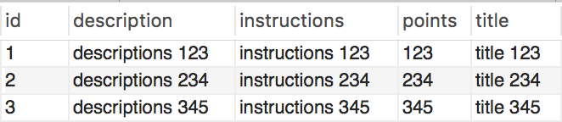


joined_base_question
joined_true_or_false_question
joined_fill_in_the_blank_question

Slide 19
SINGLE TABLE/ DENORMALIZED STRATEGY

Slide 20
BaseQuestionSingle.java
@Entity
@Table(name = "SINGLE_BASE_QUESTION")
@Inheritance(strategy=InheritanceType.SINGLE_TABLE)
public class BaseQuestionSingle {
@Id
@GeneratedValue(strategy=GenerationType.IDENTITY)
private int id;
private int points;
private String title, description, instructions; ...
}

Slide 21
TrueOrFalseQuestionSingle.java
@Entity
@Table(name =
"SINGLE_TRUE_OR_FALSE_QUESTION")
public class TrueOrFalseQuestionSingle
extends BaseQuestionSingle {
@Column(name = "IS_TRUE")
private Boolean isTrue;
}

Slide 22
FillInTheBlankQuestionSingle.java
@Entity
@Table(name =
"SINGLE_FILL_IN_THE_BLANK_QUESTION")
public class FillInTheBlankQuestionSingle
extends BaseQuestionSingle {
@Column(name = "VARIABLES")
private String variables;
}

Slide 23
single_base_question
CREATE TABLE `single_base_question` (
`dtype` varchar(31) NOT NULL,
`id` int(11) NOT NULL AUTO_INCREMENT,
`description` varchar(255) DEFAULT NULL,
`instructions` varchar(255) DEFAULT NULL,
`points` int(11) NOT NULL,
`title` varchar(255) DEFAULT NULL,
`variables` varchar(255) DEFAULT NULL,
`is_true` bit(1) DEFAULT NULL,
PRIMARY KEY (`id`)
)
this is the only table needed in single table strategy. all data is stored in one table. all fields in one table

Slide 24
*RepositorySingle.java (one repository per class)
public interface BaseQuestionRepositorySingle
extends CrudRepository
<BaseQuestionSingle, Integer>{}
public interface TrueOrFalseQuestionRepositorySingle
extends CrudRepository
<TrueOrFalseQuestionSingle, Integer>{}
public interface FillInTheBlankQuestionRepositorySingle
extends CrudRepository
<FillInTheBlankQuestionSingle, Integer>{}

Slide 25
ServiceSingle.java (same as ServiceJoined.java)
@RestController
public class ServiceSingle {
@Autowired
BaseQuestionRepositorySingle baseRepo;
@Autowired
FillInTheBlankQuestionRepositorySingle fillRepo;
@Autowired
TrueOrFalseQuestionRepositorySingle trueRepo; ...
}

Slide 26
ServiceSingle.java (different mappings/returns)
@GetMapping("/api/inheritance/single/base")
public BaseQuestionSingle
createBaseQuestion() {...}
@GetMapping("/api/inheritance/single/fill")
public FillInTheBlankQuestionSingle
createFillQuestion() {...}
@GetMapping("/api/inheritance/single/true")
public TrueOrFalseQuestionSingle
createTrueQuestion() {...}

Slide 27
http://localhost:8080/api/inheritance/single/base
{
"id": 1,
"points": 123,
"title": "title 123",
"description": "descriptions 123",
"instructions": "instructions 123"
}
responses are same as with joined strategy

Slide 28
http://localhost:8080/api/inheritance/single/fill
{
"id": 0,
"points": 234,
"title": "title 234",
"description": "descriptions 234",
"instructions": "instructions 234",
"variables": "variables 234"
}

Slide 29
http://localhost:8080/api/inheritance/single/true
{
"id": 0,
"points": 345,
"title": "title 345",
"description": "descriptions 345",
"instructions": "instructions 345",
"isTrue": true
}

Slide 30
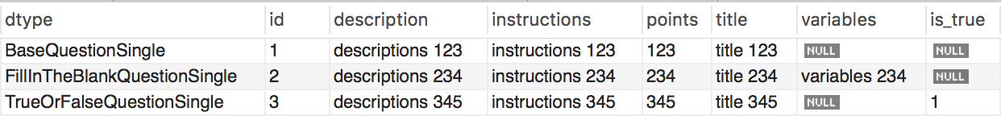
SELECT *
FROM single_base_question;

Slide 31
TABLE PER CLASS STRATEGY

Slide 32
BaseQuestionPerClass.java
@Entity
@Table(name = "PER_CLASS_BASE_QUESTION")
@Inheritance(strategy=InheritanceType.TABLE_PER_CLASS)
public class BaseQuestionPerClass {
@Id
@GeneratedValue(strategy=GenerationType.AUTO)
private int id;
private int points;
private String title;
private String description;
private String instructions;
}

Slide 33
per_class_base_question
CREATE TABLE `per_class_base_question` (
`id` int(11) NOT NULL,
`description` varchar(255) DEFAULT NULL,
`instructions` varchar(255) DEFAULT NULL,
`points` int(11) NOT NULL,
`title` varchar(255) DEFAULT NULL,
PRIMARY KEY (`id`)
)

Slide 34
per_class_true_or_false_question
CREATE TABLE `per_class_true_or_false_question` (
`id` int(11) NOT NULL,
`description` varchar(255) DEFAULT NULL,
`instructions` varchar(255) DEFAULT NULL,
`points` int(11) NOT NULL,
`title` varchar(255) DEFAULT NULL,
`is_true` bit(1) NOT NULL,
PRIMARY KEY (`id`)
)

Slide 35
per_class_fill_in_the_blank_question
CREATE TABLE `per_class_fill_in_the_blank_question` (
`id` int(11) NOT NULL,
`description` varchar(255) DEFAULT NULL,
`instructions` varchar(255) DEFAULT NULL,
`points` int(11) NOT NULL,
`title` varchar(255) DEFAULT NULL,
`variables` varchar(255) NOT NULL,
PRIMARY KEY (`id`)
)

Slide 36
ServicePerClass.java (same as ServiceJoined.java)
@RestController
public class ServicePerClass {
@Autowired
BaseQuestionRepositoryPerClass baseRepo;
@Autowired
FillInTheBlankQuestionRepositoryPerClass fillRepo;
@Autowired
TrueOrFalseQuestionRepositoryPerClass trueRepo; ...
}

Slide 37
ServicePerClass.java (different mappings/returns)
@GetMapping("/api/inheritance/preclass/base")
public BaseQuestionPerClass
createBaseQuestion() {...}
@GetMapping("/api/inheritance/preclass/fill")
public FillInTheBlankQuestionPerClass
createFillQuestion() {...}
@GetMapping("/api/inheritance/preclass/true")
public TrueOrFalseQuestionPerClass
createTrueQuestion() {...}

Slide 38
http://localhost:8080/api/inheritance/perclass/base
{
"id": 1,
"points": 123,
"title": "title 123",
"description": "descriptions 123",
"instructions": "instructions 123"
}
responses are same as with joined strategy

Slide 39
http://localhost:8080/api/inheritance/perclass/fill
{
"id": 0,
"points": 234,
"title": "title 234",
"description": "descriptions 234",
"instructions": "instructions 234",
"variables": "variables 234"
}

Slide 40
http://localhost:8080/api/inheritance/perclass/true
{
"id": 0,
"points": 345,
"title": "title 345",
"description": "descriptions 345",
"instructions": "instructions 345",
"isTrue": true
}

Slide 41
Reference
https://www.thoughts-on-java.org/complete-guide-inheritance-strategies-jpa-hibernate/
http://blog.netgloo.com/2014/12/18/handling-entities-inheritance-with-spring-data-jpa/

